Slide 1
NIST Testing Approach Overview: Using the HL7 V2 LOI Validation Tool
Laboratory Order Interface (LOI) – Ambulatory EHR-S
Robert Snelick, NIST (rsnelick@nist.gov)
August 12, 2014

Slide 2
Purpose
Provide an additional resource to explain the process of EHR testing related to HL7 V2 Laboratory Orders Interface (LOI) Messaging
Describe NIST approach for assessing and validating the test messages
Provide an overview of the testing requirements

Slide 3
Table of Contents
List of Resources
Scope of NIST LOI Testing
Testing Procedure and Testing Workflow Diagrams
Explanation of Test Scenarios and Test Cases
Example Test Case Documents
Explanation of Test Data Categorization/Validation
Test Tool Overview and Example Test Tool Screen
FAQ for LOI Test Tool
Additional Resources

Slide 4
Resources
LOI Test Plan (on Documentation Tab)
Test Tool Web Site (http://hl7v2-loi-r1-testing.nist.gov ) Beta Version
Validation Tools
User Documentation
S&I Framework Lab Order Interface (LOI) Implementation Guide
(http://www.hl7.org/implement/standards/product_brief.cfm?product_id=152)
LOI Tool Quick Reference Guide (In Process)
LOI Tool Tutorial (In Process)
Release Notes for each version of Test Tool (on Documentation Tab)
LOI Test Tool Google Group for submitting questions to the Test Tool developers
(https://groups.google.com/forum/?hl=en#!forum/hl7v2-lab-orders-interface-testing)

Slide 5
Scope of NIST Testing
NIST testing is directed at an EHR product, not specific instances (implementations) of an EHR system
NIST LOI testing focuses on the capability of the EHR product to electronically create lab order messages in accordance with standards for electronic transmission from ambulatory EHRs
Transmission of the messages is not being tested
Receiving LIS* are not being tested using the LOI Context-based validation tool; however, the receiving LIS should be capable of processing the data included in the LOI test message
Testing focus and scope is narrow
*Laboratory Information Systems
Testing encompasses only the specific use case indicated in the LOI implementation guide
Testing does not attempt to address the entire spectrum of use cases found in practice or specified in implementation guides
NIST testing is driven by the test data
NIST is testing the capability of an EHR product to create lab order messages for transmission from ambulatory EHRs using specific data
The Test Cases provided do not cover the full extent of use cases specified in the implementation guide; through consultation with clinical laboratory experts, a subset of key lab tests were selected for testing
The testing will not demonstrate complete conformance to the implementation guide, as it is not practical for this testing to be exhaustive
Clinical laboratory subject matter experts, in collaboration with the National Institute of Standards and Technology (NIST), provided the Test Scenarios, Test Cases, and Test Data for the NIST Laboratory Order Interface testing

Slide 6
NIST Lab Order Interface Testing
Evaluates the capability for an ambulatory EHR technology to electronically create laboratory orders for electronic transmission to laboratory information systems
Using HL7 Version 2.5.1 Implementation Guide: S&I Framework Laboratory Orders from EHR (Referred to as LOI)
Using LOINC® version 2.40 (at a minimum)
With all the information for a test requisition as specified at 42 CFR 493.1241(c)(1) through (c)(8)
The LOI Test Tool targets the create aspect, evaluating the capability of the EHR to electronically create the LOINC-encoded laboratory test result message in a conformant HL7 v2.5.1 format
The testing focuses on the proper implementation of the LOI specification; how the laboratory order is sent from an ambulatory EHR to an LIS is not within the scope

Slide 7
Referenced Standards - Lab Order Interface
42 CFR 493.1241 Standard: Test request. (c) The laboratory must ensure the test requisition solicits the following information:
(1) The name and address or other suitable identifiers of the authorized person requesting the test and, if appropriate, the individual responsible for using the test results, or the name and address of the laboratory submitting the specimen, including, as applicable, a contact person to enable the reporting of imminently life threatening laboratory results or panic or alert values.
(2) The patient's name or unique patient identifier.
(3) The sex and age or date of birth of the patient.
(4) The test(s) to be performed.
(5) The source of the specimen, when appropriate.
(6) The date and, if appropriate, time of specimen collection.
(7) For Pap smears, the patient's last menstrual period, and indication of whether the patient had a previous abnormal report, treatment, or biopsy.
(8) Any additional information relevant and necessary for a specific test to ensure accurate and timely testing and reporting of results, including interpretation, if applicable.
Implementation specifications for exchanging electronic health information
HL7 Version 2.5.1 Implementation Guide: S&I Framework Laboratory Orders from EHR
Vocabulary standards for representing electronic health information
Logical Observation Identifiers Names and Codes (LOINC®) Database version 2.40, a universal code system for identifying laboratory and clinical observations produced by the Regenstrief Institute, Inc.

Slide 8
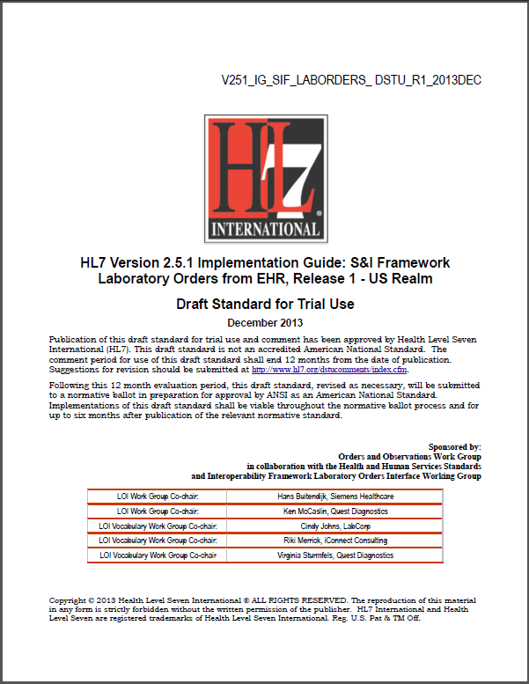
Referenced Standards Documents
HL7 2.5.1 LOI Implementation Guide Release 1 DSTU
http://www.hl7.org/implement/standards/product_brief.cfm?product_id=152

Slide 9
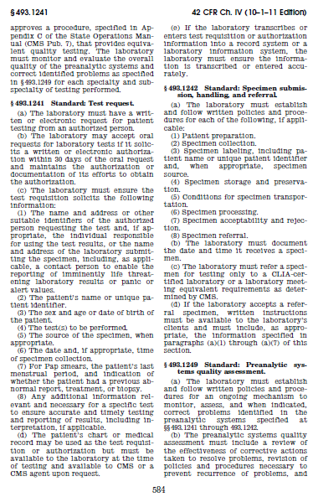
Referenced Standards Documents
42 CFR 493.1241 Standard: Test request.
http://www.gpo.gov/fdsys/granule/CFR-2011-title42-vol5/CFR-2011-title42-vol5-sec493-1241/content-detail.html

Slide 10

Referenced Standards Web Site
LOINC® Database version 2.40 (at a minimum)
http://loinc.org/

Slide 11
LOI Validation Tool Overview
Purpose: The tool validates LOI messages created by EHR technology
Tool Key Capabilities
LOI Context-free Validation | (No Test Cases - Test any LOI message created by EHR senders Context (e.g. type and results of lab test) is unknown to validation tool Provides a simple and convenient method for testing message structure and most vocabulary
LOI Context-based Validation | (Test Cases - Test LOI message associated with a specific test scenario) Context (e.g. type and results of lab test) is known to validation tool All conformance requirements of LOI implementation guide can be assessed (Context-base Validation is used for certifying EHR technology for Meaningful Use)
Profile Viewer | Provides a browsable version of the conformance profile which encapsulates the requirements. Can be used to assist in the interpretation of errors.
Vocabulary Browser | Provides a browsable view of the vocabulary requirements. Can be used to assist in the interpretation of value set errors.
Documentation | Provides access to documents which will assist in using the tool (including test plans, data sheet and juror document supplements).

Slide 12
Lab Orders from Ambulatory EHR Testing Procedure
HL7 LOI IG December 2013
Ambulatory EHR
(System under Test)
LIS
Meaningful Use Scope
OML Message
OML Elements
Direct Data Entry
Message
Captured
NIST Validation Tool
OML Message Elements
The Ambulatory EHR is the system being tested. The EHR system is required to create messages that conform to the referenced standards (See previous slides).
Test data can be entered into EHR directly via the EHR’s user interface or can be imported via some other method
The EHR is expected to process the test data to create a message. This message is captured and uploaded into the testing tool for validation.
Test data are available in the Test Tool via the Test Cases in the Context-based Validation. Each Test Case includes a Test Story that provides the context, a Test Data Specification that lists the test data, and a Message Content Data Sheet that shows a conformant message (in a table format) including a detailed profile of the required elements

Slide 13
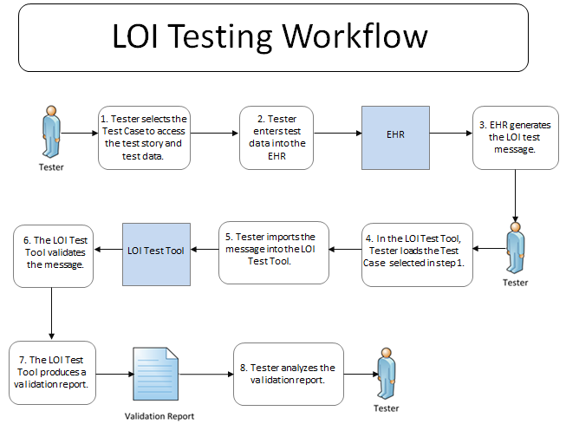
Testing Workflow Diagram for Context-based Validation
This diagram shows
How the major steps of the context-based test are sequenced
When the Test Tool is to be used

Slide 14
Test Scenarios and Associated Test Cases
Each of the LOI test cases
Addresses a specific test scenario
Consists of a Test Story, Test Data Specification sheet, and Message Content sheet
Includes LOI test data for lab tests ordered by an EHR-S in the ambulatory setting
One test case is a “smoke test” for demonstration of basic LOI capabilities and should be completed prior to beginning the other test cases
Test cases and specific test data are provided for four profile options defined in the LOI implementation guide (see next slide for details about these profile options)

Slide 15
Test Scenarios and Associated Test Cases (cont’d)
The HL7 Version 2.5.1 Implementation Guide: S&I Framework Lab Orders from EHR (LOI) interoperability standard defines four profile options that are relevant for NIST Context-based Validation
These profile options are composed of Pre-Coordinated OIDs or combinations of Component OIDs used to populate MSH.21 (Message Profile Identifier)
For the purpose of NIST Context-based Validation, the Vendor will declare which one of the four profile options they are claiming for conformance
The test cases are grouped in the test tool by GU or NG
LOI Profile | Pre-Coordinated OID | Component OIDs | Component Name
LOI_GU_PRU_Profile | 2.16.840.1.113883.9.85 | 2.16.840.1.113883.9.66 2.16.840.1.113883.9.78 2.16.840.1.113883.9.82 | LOI_Common_Component LOI_GU_Component LAB_PRU_Component
LOI_GU_PRN_Profile | 2.16.840.1.113883.9.86 | 2.16.840.1.113883.9.66 2.16.840.1.113883.9.78 2.16.840.1.113883.9.81 | LOI_Common_Component LOI_GU_Component LAB_PRN_Component
LOI_NG_PRU_Profile | 2.16.840.1.113883.9.87 | 2.16.840.1.113883.9.66 2.16.840.1.113883.9.79 2.16.840.1.113883.9.82 | LOI_Common_Component LOI_NG_Component LAB_PRU_Component
LOI_NG_PRN_Profile | 2.16.840.1.113883.9.88 | 2.16.840.1.113883.9.66 2.16.840.1.113883.9.79 2.16.840.1.113883.9.81 | LOI_Common_Component LOI_NG_Component LAB_PRN_Component
The PRN profiles apply only to the GHP and Creatinine Clearance test cases in the LOI test tool

Slide 16
Test Scenarios and Associated Test Cases (cont’d)
Context-free Validation in the LOI test tool may be used to evaluate messages containing the following additional optional profile components:
Example messages containing these optional components are available on the Documentation tab in the LOI test tool
Component OIDs | Component Name
2.16.840.1.113883.9.80 2.16.840.1.113883.9.94 | LAB_FI_Component (Financial Information) LOI_PH_COMPONENT (Public Health)

Slide 17
Test Scenarios and Associated Test Cases (cont’d)
Depending on which profile is claimed by the Vendor
The Tester shall use the NG test cases, and shall use either NG_PRU or NG_PRN for the GHP (Initial Order) and Creatinine Clearance test cases or
The Tester shall use the GU test cases, and shall use either GU_PRU or GU_PRN for the GHP (Initial Order) and Creatinine Clearance test cases
Test Scenario | NG Test Cases | GU Test Cases
Minimally Populated Prothrombin Time – Initial Order (Smoke Test) | LOI_0.0_1.1-NG | LOI_0.0_1.1-GU
Typically Populated Sed Rate message – Initial Order via Ambulatory EHR | LOI_1.0_1.1-NG | LOI_1.0_1.1-GU
Typically Populated Sed Rate message – Order Cancelled via Ambulatory EHR | LOI_1.0_2.1-NG | LOI_1.0_2.1-GU
Typically Populated Sed Rate message – Order Cancelled by Lab | LOI_1.0_3.1-NG | LOI_1.0_3.1-GU
Typically Populated CBC – Initial Order | LOI_2.0_1.1-GU | LOI_2.0_1.1-GU
Typically Populated Lipid Panel – Initial Order | LOI_3.0_1.1-NG | LOI_3.0_1.1-GU
Typically Populated Lipid Panel – Initial Order | LOI_3.1_1.1-NG | LOI_3.1_1.1-GU
Typically Populated Culture and Susceptibility – Microbiology – Initial Order | LOI_4.0_1.1-NG | LOI_4.0_1.1-GU
Typically Populated Hepatitis – Reflex – Initial Order | LOI_5.0_1.1-NG | LOI_5.0_1.1-GU
Typically Populated Pap Smear – Anatomical Pathology – Initial Order | LOI_6.0_1.1-NG | LOI_6.0_1.1-GU
Typically Populated GHP – Initial Order | LOI_7.0_1.1-NG_PRU OR LOI_7.0_1.1-NG_PRN | LOI_7.0_1.1-GU_PRU OR LOI_7.0_1.1-GU_PRN
Typically Populated GHP – Add-On Order | LOI_7.0_2.1-NG | LOI_7.0_2.1-GU
Typically Populated Creatinine Clearance – Initial Order | LOI_9.0_1.1-NG_PRU OR LOI_9.0_1.1-NG_PRN | LOI_9.0_1.1-GU_PRU OR LOI_9.0_1.1-GU_PRN
Typically Populated Prostate Biopsy – Anatomical Pathology – Initial Order | LOI_10.0_1.1-NG | LOI_10.0_1.1-GU

Slide 18
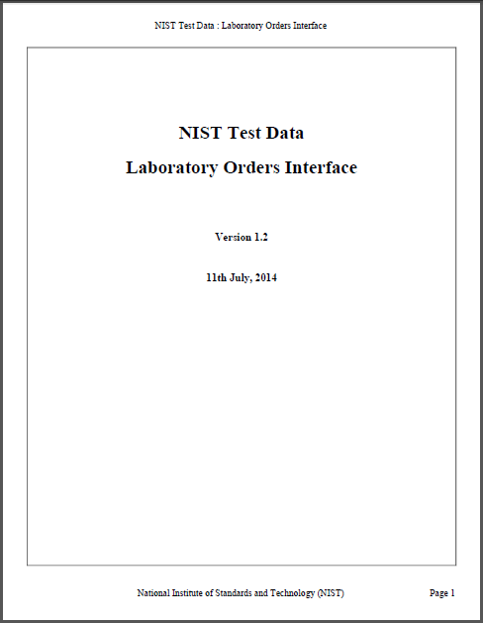
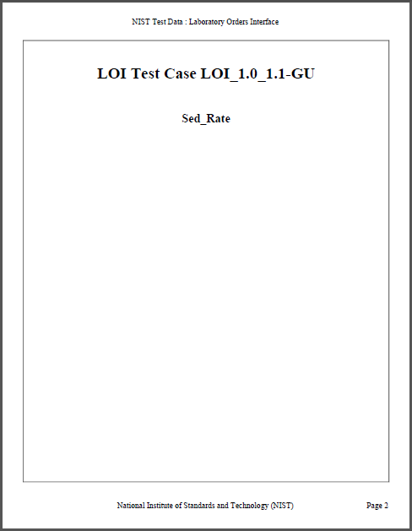
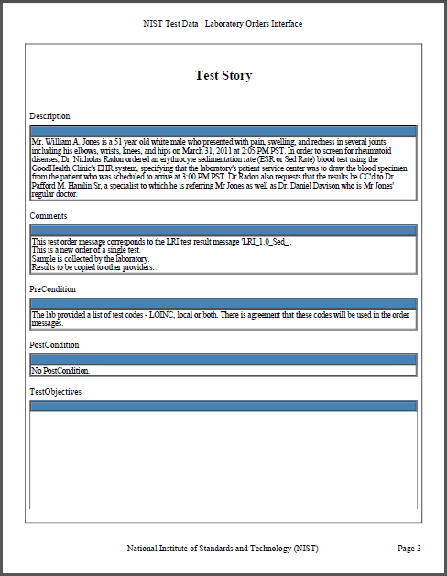
The Test Data Documents for Each Test Case
Each Test Case includes a narrative Test Story that describes a real world situation and provides context for the Test Case
Example: Test Data pdf document for the LOI_1.0_1.1-GU_PRU Sed Rate Order Test Case

Slide 19
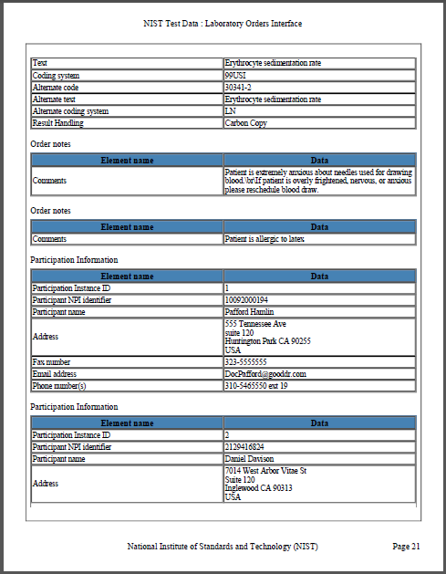
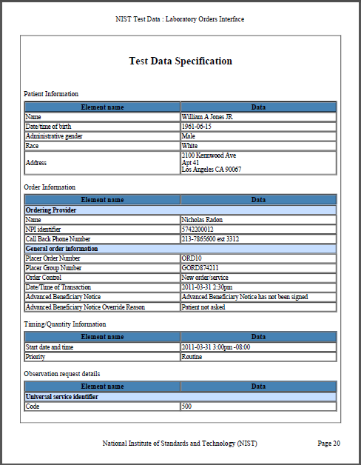
The Test Data Documents for Each Test Case (cont’d)
Each Test Case includes a Test Data Specification that
Lists data associated with the Test Story
Consists of typical information found in the clinical setting
Along with the Test Story, provides sufficient information to be entered into the EHR for the Test Case
A test message is generated using these data and the EHR functions
Example: Test Data pdf document for the LOI_1.0_1.1-GU_PRU Sed Rate Order Test Case
19
Notes:
19

Slide 20
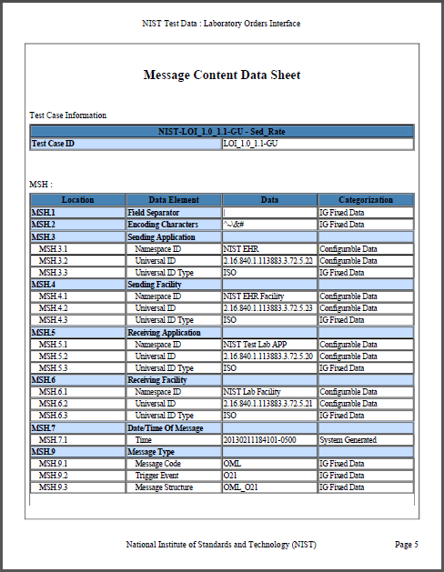
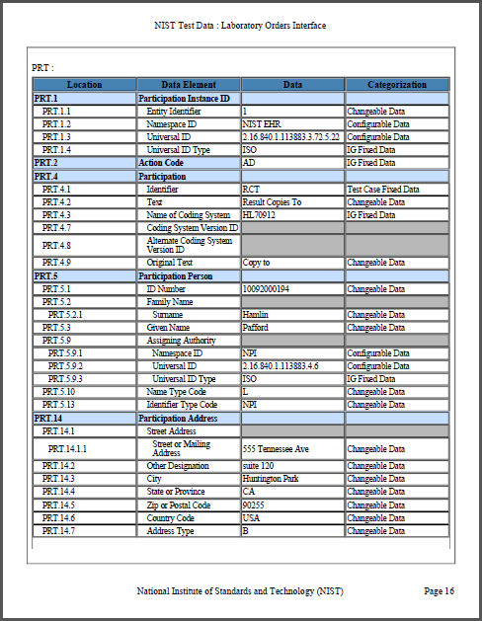
The Test Data Documents for Each Test Case (cont’d)
Each Test Case includes a Message Content Data Sheet that shows a conformant message instance
The category of the test data is listed in the Categorization column
Example: Test Data pdf document for the LOI_1.0_1.1-GU_PRU Sed Rate Order Test Case
20
Notes:
20

Slide 21
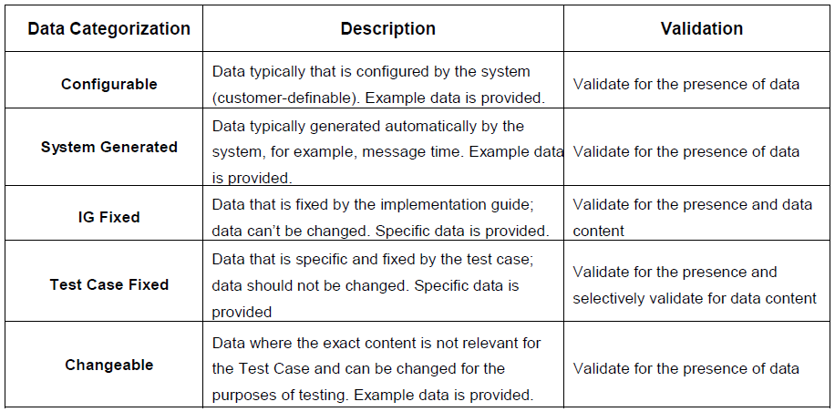
Test Data Categorization and Validation
The Message Content Data Sheet shows the categorization of the test data that are provided for each Location
The category assigned to the data is directly related to how the associated message content is validated by the Test Tool, as shown in the table below

Slide 22
Test Data Validation
The Test Tool validates a message for the presence and exact content of the data for Locations assigned to the IG Fixed category and the Test Case Fixed category
The Test Tool validates a message for the presence of data for Locations assigned to any of the other categories
These data are necessary for the transaction, but the exact content is either not relevant for the Test Case or may be system-dependent
Example: Universal ID for the Performing Organization
The testing laboratory may also inspect the message during validation; the Inspection Test Guides in the Test Procedure document provide guidance
Location | Value | Category | Assessment
PRT.4.1 | RTC | Test Case Fixed Data | Content must be present and exactly “RTC”
PRT.4.2 | Result Copies To | Changeable Data | Content must be present and should be a value equivalent to “Result Copies To”
PRT.4.3 | HL70912 | IG Fixed Data | Content must be present and exactly “HL70912”
MSH.3.1 | NIST EHR | Configurable Data | Content must be present and should be an equivalent value
MSH.3.3 | ISO | IG Fixed Data | Content must be present and exactly “ISO”

Slide 23
LOI Validation Tool Overview
Purpose: The tool validates LOI messages created by EHR technology
Tool Key Capabilities
LOI Context-free Validation | (No Test Cases - Test any LOI message created by EHR senders Context (e.g. type and results of lab test) is unknown to validation tool Provides a simple and convenient method for testing message structure and most vocabulary
LOI Context-based Validation | (Test Cases - Test LOI message associated with a specific test scenario) Context (e.g. type and results of lab test) is known to validation tool All conformance requirements of LOI implementation guide can be assessed
Profile Viewer | Provides a browsable version of the conformance profile which encapsulates the requirements. Can be used to assist in the interpretation of errors.
Vocabulary Browser | Provides a browsable view of the vocabulary requirements. Can be used to assist in the interpretation of value set errors.
Documentation | Provides access to documents which will assist in using the tool (including test plans, data sheet and juror document supplements).
No registration or log-in credentials are needed. Simply click link on the link below and send/paste/load message into tool to obtain a Validation Report.
NOTE: The Test Tool (.war file) can also be downloaded and installed locally.
NOTE: Web Application is compatible with Internet Explorer versions 8 and 9, Firefox, and Chrome. Recommended browsers are Internet Explorer 9, Firefox and Chrome.
Register to Google Group at: https://groups.google.com/forum/?hl=en#!forum/hl7v2-lab-orders-interface-testing to ask questions and provide feedback.
http://hl7v2-loi-r1-testing.nist.gov

Slide 24
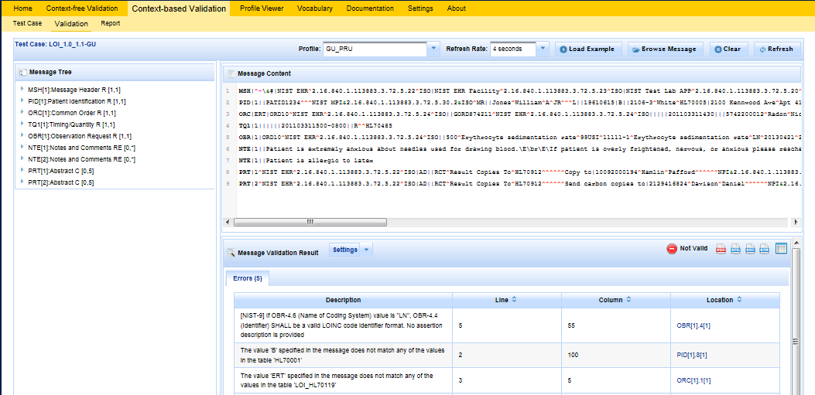
Example LOI Test Tool Screen
LOI Tool Tutorial (In Process) provides a full guide
1
Context-free or Context-based Validation.
2
Uploaded test message displays.
3
If message fails validation, errors will display in Message Validation Result section of page.
4
Click on location link to highlight the data element causing the error within the Message Tree and Content.
Note: Location link may not be available if the message element location does not map to a message element in the message tree.

Slide 25
FAQ –Lab Order Interface
Frequently Asked Questions
What is the difference between context-free and context-based validation?
With the context-based validation method, the messages created by the EHR technology are populated using the Test Data provided in the Test Cases associated with specific Test Scenarios. These Test Scenarios and Test Cases are accessed via the Context-based Validation part of the Test Tool, and this "context" (along with all conformance requirements of the LOI implementation guide) is "known" to the validation tool. The Context-free Validation method may be used to test any lab order message created by an EHR. It provides an easy way to test message structure and most vocabulary, but the context (Test Scenario, etc.) is unknown to the Test Tool.
In the Message Content sheet, what does “Changeable Data” mean?
"Changeable data“ means the exact content of the data for the data element is not relevant to the testing. The NIST Test Tool will check for the presence of data to verify that the system supports the particular data element, but the tool does not check for specific content. NIST provides example values in the Test Data, but anticipates that local installations would provide their local values.
In the Message Content sheet, what does “Configurable Data” mean?
“Configurable Data” indicates data that typically are system-defined. The NIST Test Tool will check for the presence of data to verify that the system supports the particular data element, but the tool does not check for specific content. NIST provides example values in the Test Data.
What is the difference between “R”, “RE”, and “O” Usage for data elements?
“R” means that the data element is “Required”, and it must be populated in the test messages for certification testing. “RE” means that the data element is “Required, but may be empty”, and it must be populated in the test messages for certification testing IF TEST DATA ARE PROVIDED FOR THE DATA ELEMENT. “O” means that the data element is “Optional, and it is not in-scope for certification testing.

Slide 26
Resources
Test Tool Web Site (http://hl7v2-loi-r1-testing.nist.gov) provides
Test Tool (API, Web Application, and Desktop)
Test Cases / Test Stories / Message Content Details / Test Data / User Documentation
Test Plan
Example messages
Testing Artifacts
Message Profile
Value Sets
Contact
Rob Snelick (rsnelick@nist.gov)

